Slide 1
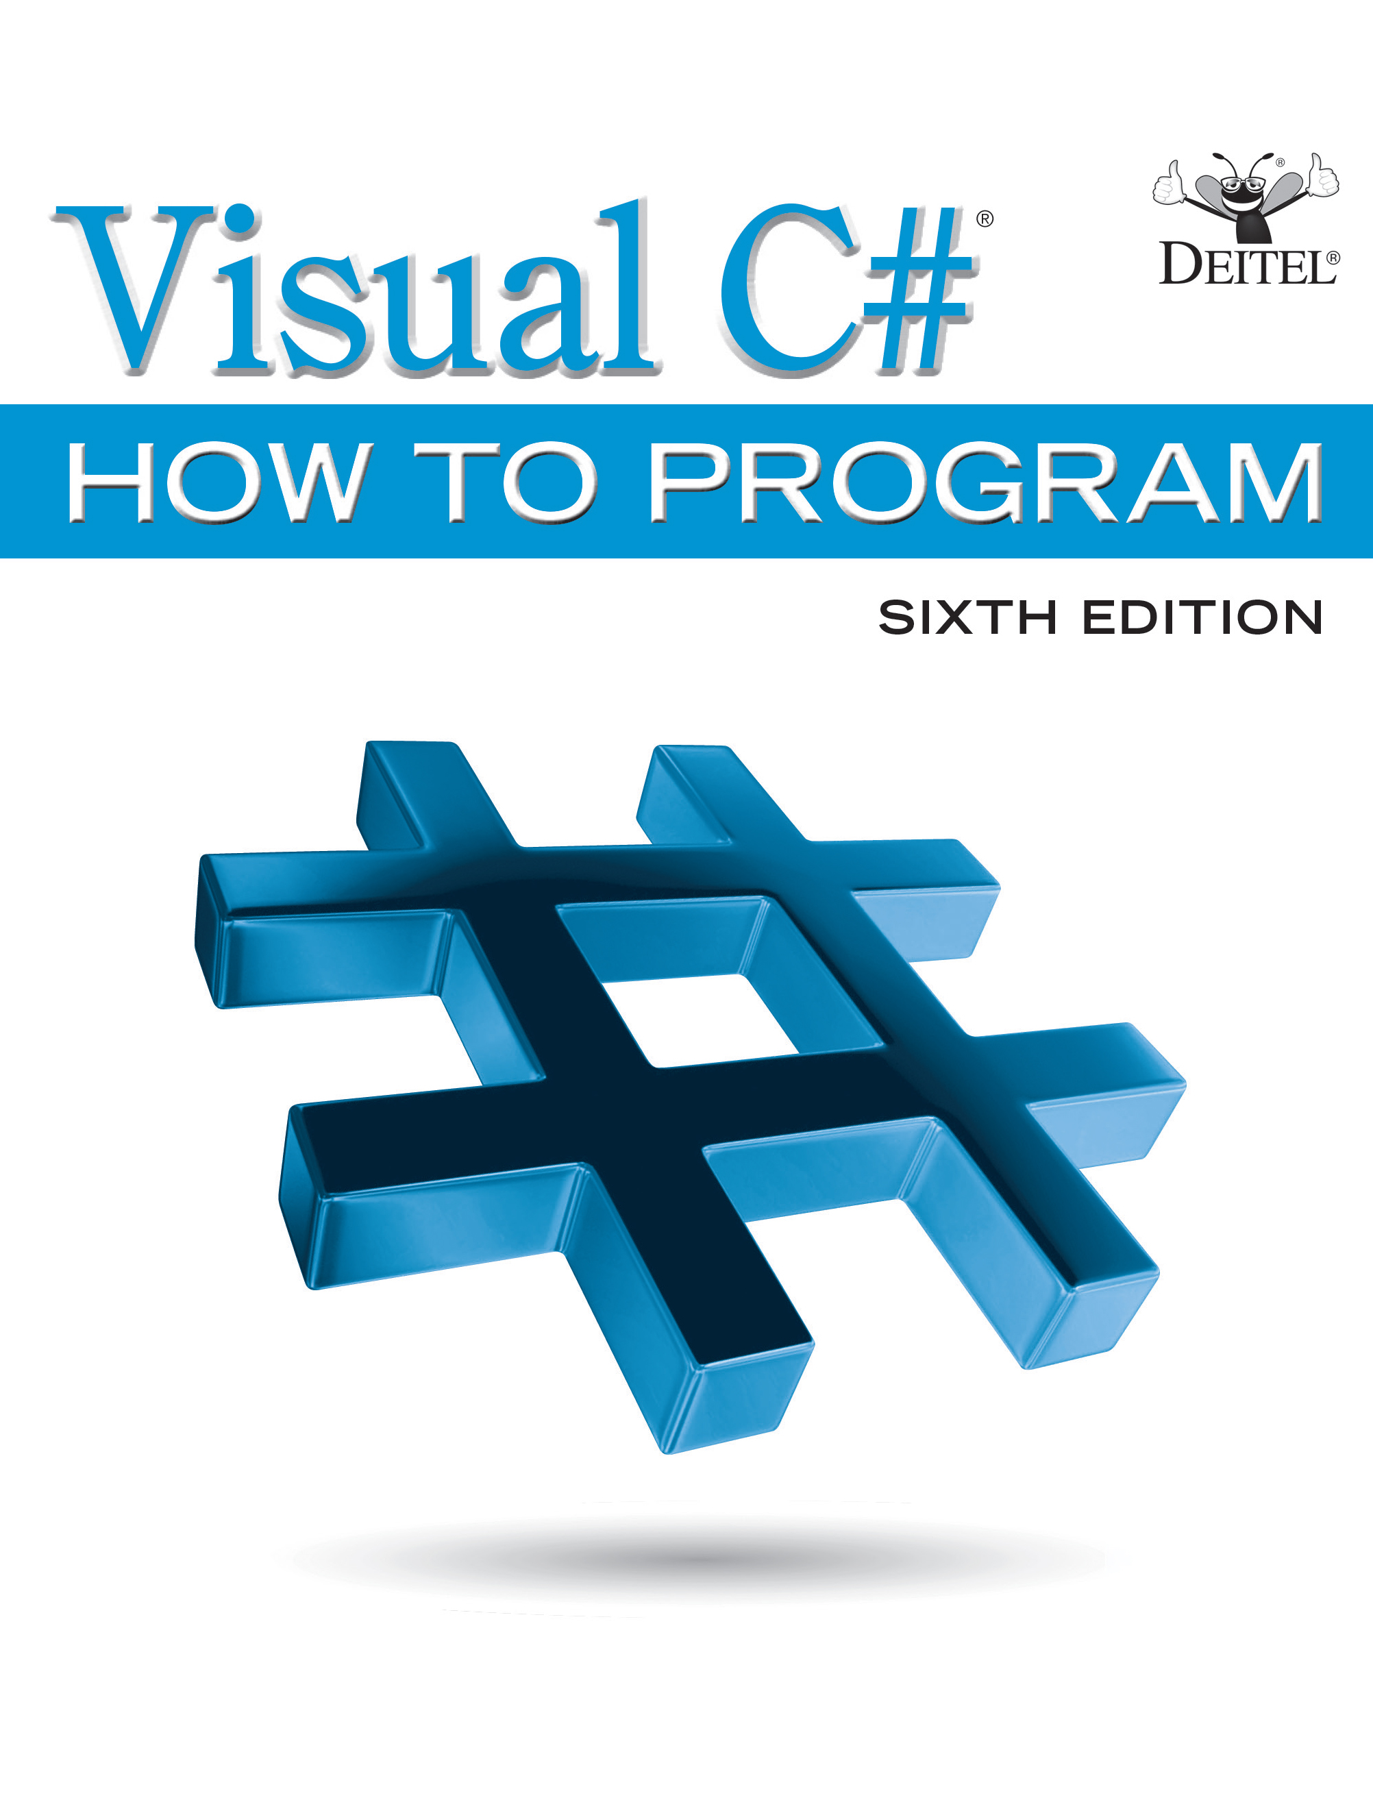
Visual C sharp® How to Program
Sixth Edition
Chapter 5
Algorithm Development and
Control Statements: Part 1
Copyright © 2017 Pearson Education, Inc. All Rights Reserved
Notes:
If this PowerPoint presentation contains mathematical equations, you may need to check that your computer has the following installed:
1) MathType Plugin
2) Math Player (free versions available)
3) NVDA Reader (free versions available)

Slide 2
Learning Objectives
Learn basic problem-solving techniques.
Develop algorithms through the process of top-down, stepwise refinement with pseudocode.
Use the if and if…else selection statements to choose between actions.
Use the while statement to execute statements repeatedly.
Use counter-controlled iteration and sentinel-controlled iteration.
Use nested control statements.
Use the increment, decrement and compound assignment operators.
Learn about the simple types.
Understand the elements of structured programming with the sequence, selection and iteration control structures.

Slide 3
Outline (1 of 6)
5.1 Introduction
5.2 Algorithms
5.3 Pseudocode
5.4 Control Structures
5.4.1 Sequence Structure
5.4.2 Selection Statements
5.4.3 Iteration Statements
5.4.4 Summary of Control Statements
5.5 if Single-Selection Statement

Slide 4
Outline (2 of 6)
5.6 if…else Double-Selection Statement
5.6.1 Nested if…else Statements
5.6.2 Dangling-else Problem
5.6.3 Blocks
5.6.4 Conditional Operator (?:)
5.7 Student Class: Nested if…else Statements
5.8 while Iteration Statement

Slide 5
Outline (3 of 6)
5.9 Formulating Algorithms: Counter-Controlled Iteration
5.9.1 Pseudocode Algorithm with Counter-Controlled Iteration
5.9.2 Implementing Counter-Controlled Iteration
5.9.3 Integer Division and Truncation
5.10 Formulating Algorithms: Sentinel-Controlled Iteration
5.10.1 Top-Down, Stepwise Refinement: The Top and First Refinement
5.10.2 Second Refinement

Slide 6
Outline (4 of 6)
5.10.3 Implementing Sentinel-Controlled Iteration
5.10.4 Program Logic for Sentinel-Controlled Iteration
5.10.5 Braces in a while Statement
5.10.6 Converting Between Simple Types Explicitly and Implicitly
5.10.7 Formatting Floating-Point Numbers
5.11 Formulating Algorithms: Nested Control Statements
5.11.1 Problem Statement
5.11.2 Top-Down, Stepwise Refinement: Pseudocode Representation of the Top

Slide 7
Outline (5 of 6)
5.11.3 Top-Down, Stepwise Refinement: First Refinement
5.11.4 Top-Down, Stepwise Refinement: Second Refinement
5.11.5 Complete Second Refinement of the Pseudocode
5.11.6 App That Implements the Pseudocode Algorithm
5.12 Compound Assignment Operators
5.13 Increment and Decrement Operators
5.13.1 Prefix Increment versus Postfix Increment

Slide 8
Outline (6 of 6)
5.13.2 Simplifying Increment Statements
5.13.3 Operator Precedence and Associativity
5.14 Simple Types
5.15 Wrap-Up

Slide 9
5.2 Algorithms (1 of 3)
Computers solve problems by executing a series of actions in a specific order.
An algorithm is a procedure for solving a problem, in terms of:
the actions to be executed and
the order in which these actions are executed

Slide 10
5.2 Algorithms (2 of 3)
Consider the “rise-and-shine algorithm” followed by one junior executive for getting out of bed and going to work:
(1) get out of bed,
(2) take off pajamas,
(3) take a shower,
(4) get dressed,
(5) eat breakfast and
(6) carpool to work.

Slide 11
5.2 Algorithms (3 of 3)
Suppose that the same steps are performed in a different order:
(1) get out of bed,
(2) take off pajamas,
(3) get dressed,
(4) take a shower,
(5) eat breakfast,
(6) carpool to work.
In this case, the junior executive shows up for work soaking wet.
The order in which statements execute is called program control.

Slide 12
5.3 Pseudocode (1 of 2)
Pseudocode is similar to English—it’s not a programming language.
It helps you “think out” an app before attempting to write it.
A carefully prepared pseudocode app can easily be converted to a corresponding

Slide 13
5.3 Pseudocode (2 of 2)
The pseudocode of Figure 5.1 corresponds to the algorithm that inputs two integers from the user, adds these integers and displays their sum.
The pseudocode statements are simply English statements that convey what task is to be performed in

Slide 14
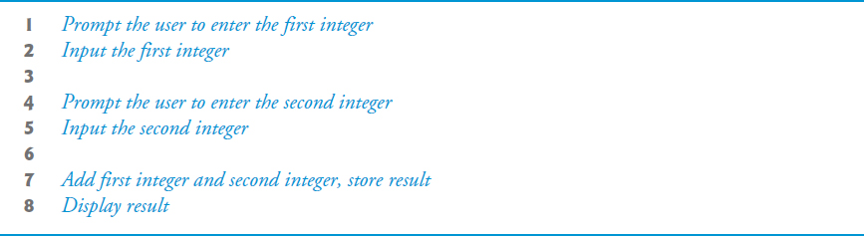
Figure 5.1 Pseudocode for the Addition Program of Figure 3.14

Slide 15
5.4 Control Structures
Normally, statements execute one after the other in sequential execution.
Various
statements enable you to specify the next
statement to execute. This is called transfer of control.
Structured apps are clearer, easier to debug and modify, and more likely to be bug free.

Slide 16
5.4.1 Sequence Structure (1 of 2)
The sequence structure is built into
Unless directed otherwise, the computer executes
statements one after the other in the order in which they’re written—that is, in sequence.
An activity diagram models the workflow of a software system (Figure 5.1).
Activity diagrams are composed of symbols such as action-state symbols, diamonds, small circles and notes.
Transition arrows represent the flow of the activity.
The solid circle represents the activity’s initial state.
The solid circle surrounded by a hollow circle represents the final state.

Slide 17
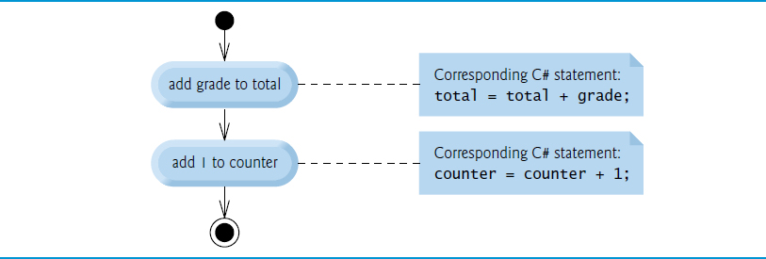
Figure 5.2 Sequence Structure Activity Diagram

Slide 18
5.4.1 Sequence Structure (2 of 2)
Single-entry/single-exit control statements make it easy to build apps.
Control statements are “attached” to one another by connecting the exit point of one to the entry point of the next.
This procedure is called control-statement stacking.
Control-statement nesting allows a control statement to appear inside another control statement.

Slide 19
5.4.2 Selection Statements
has three types of selection structures, which from this point forward we shall refer to as selection statements.
The if statement performs (selects) an action if a condition is true or skips the action if the condition is false.
The if…else statement performs an action if a condition is true or performs a different action if the condition is false.
The switch statement (Chapter 6) performs one of many different actions, depending on the value of an expression.

Slide 20
5.4.3 Iteration Statements
provides four iteration statements (sometimes called repetition statements or looping statements) that enable programs to perform statements repeatedly as long as a condition (called the loop-continuation condition) remains true.
while, do…while, for and foreach statements.
The while, for and foreach statements perform the action (or group of actions) in their bodies zero or more times.
The do…while statement performs the action (or group of actions) in its body one or more times.

Slide 21
5.4.4 Summary of Control Statements
Every app is formed by combining as many of these statements as is appropriate for the algorithm the app implements.
Each activity diagram contains an initial state and a final state that represent a control statement’s entry point and exit point, respectively.
Single-entry/single-exit control statements make it easy to build programs—we simply connect the exit point of one to the entry point of the next.
We call this control-statement stacking.
There’s only one other way in which control statements- may be connected—control-statement nesting—in which one control statement appears inside another.

Slide 22
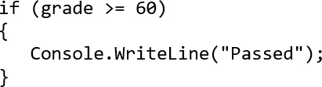
5.5 if Single-Selection Statement (1 of 3)
if grade is greater than or equal to 60
display “Passed”
The preceding pseudocode if statement may be written in
The
code corresponds closely to the pseudocode.

Slide 23
5.5 if Single-Selection Statement (2 of 3)
bool Simple Type
You saw in Chapter 3 that decisions can be based on conditions containing relational or equality operators.
A decision can be based on any expression that evaluates to true or false.
provides the simple type bool for Boolean variables that can hold only the values true and false—each of
these is a
keyword.

Slide 24
5.5 if Single-Selection Statement (3 of 3)
Figure 5.2 illustrates the single-selection if statement.
The diamond, or decision symbol indicates that a decision is to be made.
The workflow will continue along a path determined by one of the symbol’s two associated guard conditions.

Slide 25
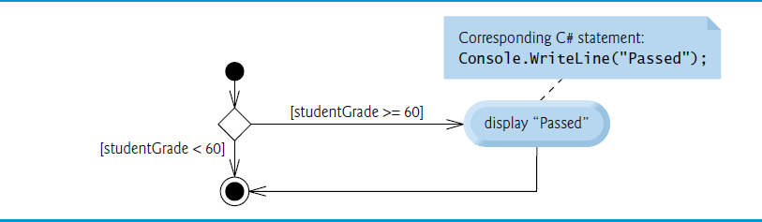
Figure 5.3 if Single-Selection Statement U M L Activity Diagram

Slide 26
5.6 if…else Double-Selection Statement (1 of 3)
The if…else double-selection statement allows you to specify an action to perform when the condition is true and a different action when the condition is false

Slide 27
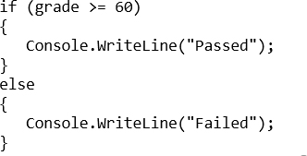
5.6 if…else Double-Selection Statement (2 of 3)
if grade is greater than or equal to 60
display “Passed”
else
display “Failed”
The preceding if…else pseudocode statement can be written in

Slide 28
Good Programming Practice 5.1
Indent both body statements of an if…else statement. Visual Studio does this for you.

Slide 29
Good Programming Practice 5.2
If there are several levels of indentation, each level should be indented the same additional amount of space. Again, we use three-space indents for book-publication purposes, but Microsoft recommends four-space indents—the default in Visual Studio.

Slide 30
5.6 if…else Double-Selection Statement (3 of 3)
Figure 5.4 illustrates the flow of control in the if…else statement.
The symbols in the U M L activity diagram represent action states and a decision.

Slide 31
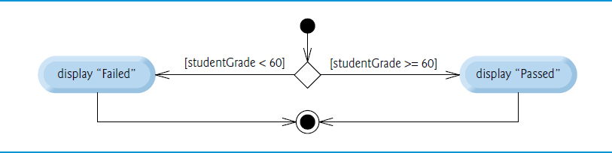
Figure 5.4 if…else Double-Selection Statement U M L Activity Diagram

Slide 32
5.6.1 Nested if…else Statements (1 of 3)
Nested if…else Statements
An app can test multiple cases with nested if…else statements:
if grade is greater than or equal to 90
display “A”
else
if grade is greater than or equal to 80
display “B”
else
if grade is greater than or equal to 70
display “C”
else
if grade is greater than or equal to 60
display “D”
else
display “F”

Slide 33
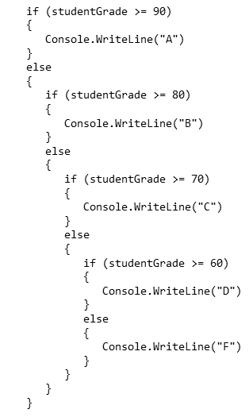
5.6.1 Nested if…else Statements (2 of 3)

Slide 34
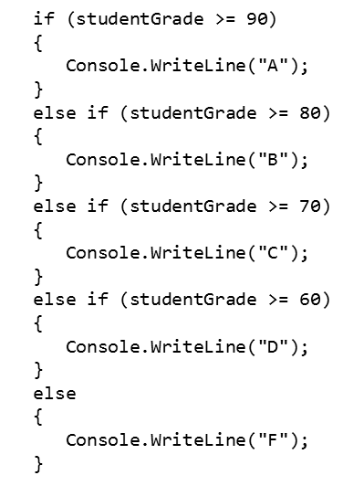
5.6.1 Nested if…else Statements (3 of 3)

Slide 35
Error-Prevention Tip 5.1
In a nested if…else statement, ensure that you test for all possible cases.

Slide 36
5.6.2 Dangling-else Problem
Throughout the text, we always enclose control statement bodies in braces ({ and }). This avoids a logic error called the “dangling-else” problem.
We investigate this problem in Exercises 5.27-5.29.

Slide 37
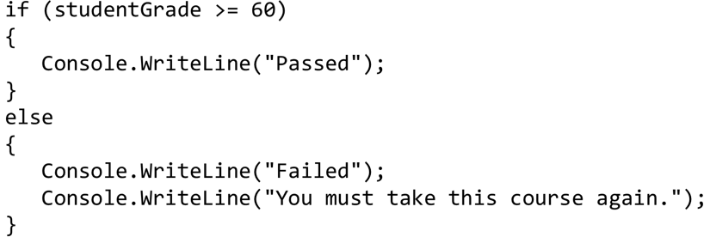
5.6.3 Blocks (1 of 2)
Statements contained within a pair of braces ({ and }) form a block:
Without the braces, the last statement in the else block would execute regardless of whether the grade was less than 60.

Slide 38
5.6.3 Blocks (2 of 2)
A logic error has its effect at execution time.
A fatal logic error causes an app to fail and terminate prematurely.
A nonfatal logic error allows an app to continue executing.

Slide 39
Common Programming Error 5.1
Placing a semicolon after the parenthesized condition in an if or if…else statement leads to a logic error in single-selection if statements and a syntax error in double-selection if…else statements (when the if-part contains a body statement).

Slide 40

5.6.4 Conditional Operator
The conditional operator
can be used in place of
an if…else statement.
The first operand is a boolean expression that evaluates to true or false.
The second operand is the value if the expression is true
The third operand is the value if the expression is false.

Slide 41
5.7 Student Class: Nested if…else Statements
The example of Figures 5.5–5.6 demonstrates a nested if…else statement that determines a student’s letter grade based on the student’s average in a course.
Read-only property LetterGrade (lines 39–68) uses nested if…else statements to determine the Student’s letter grade based on the Student’s average.
A read-only property provides only a get accessor.
Local variable letterGrade is initialized to string.Empty (line 43), which represents the empty string (that is, a string containing no characters).

Slide 42
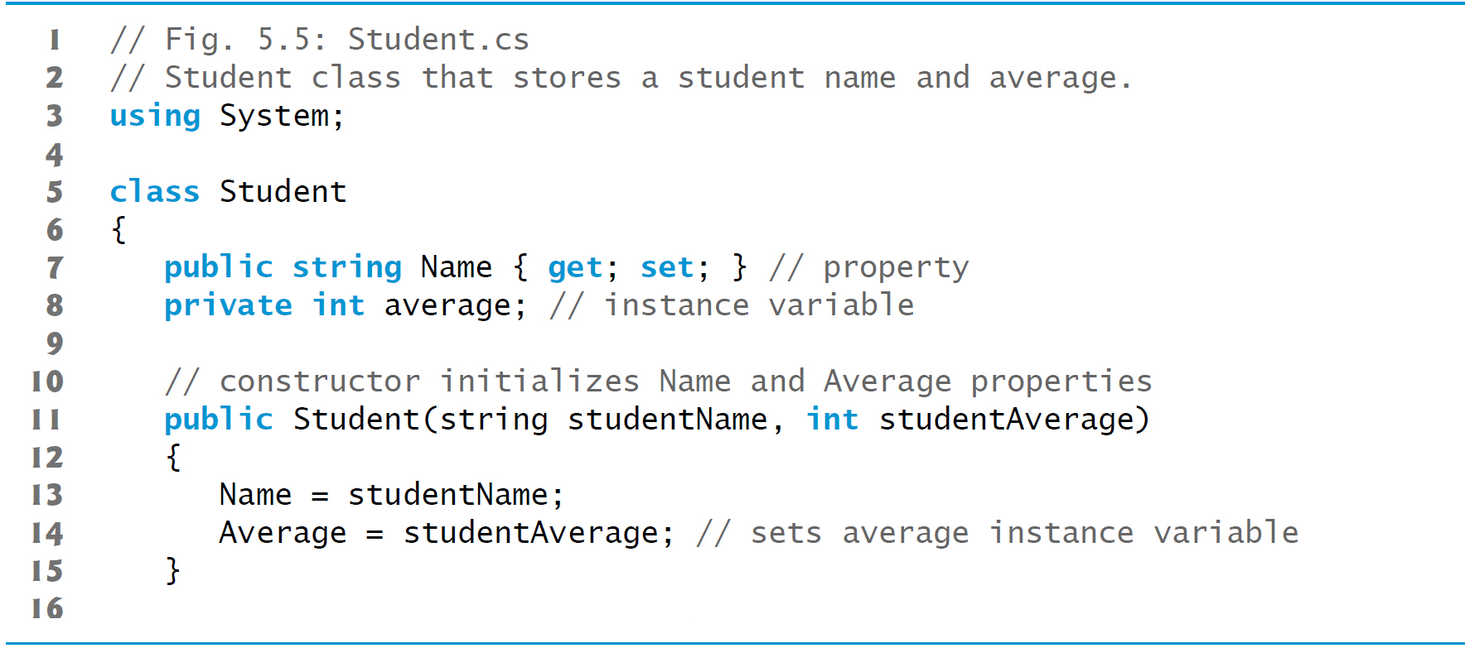
Figure 5.5 Student Class That Stores a Student Name and Average (1 of 4)

Slide 43
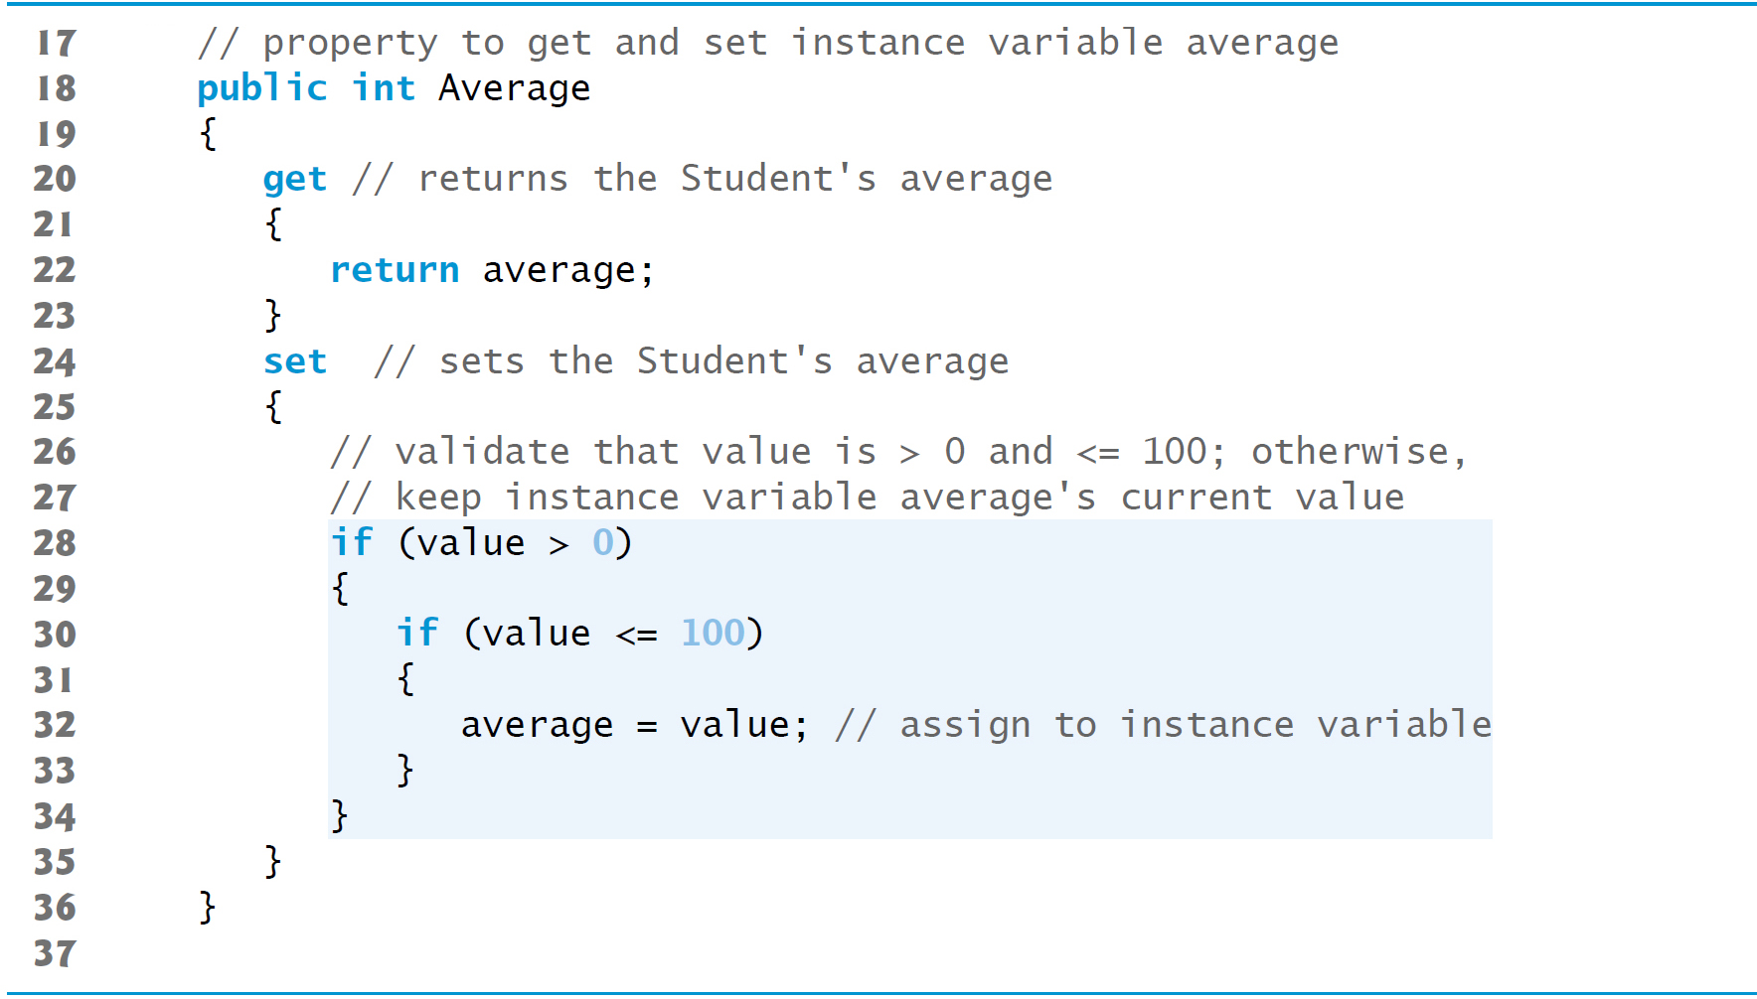
Figure 5.5 Student Class That Stores a Student Name and Average (2 of 4)

Slide 44
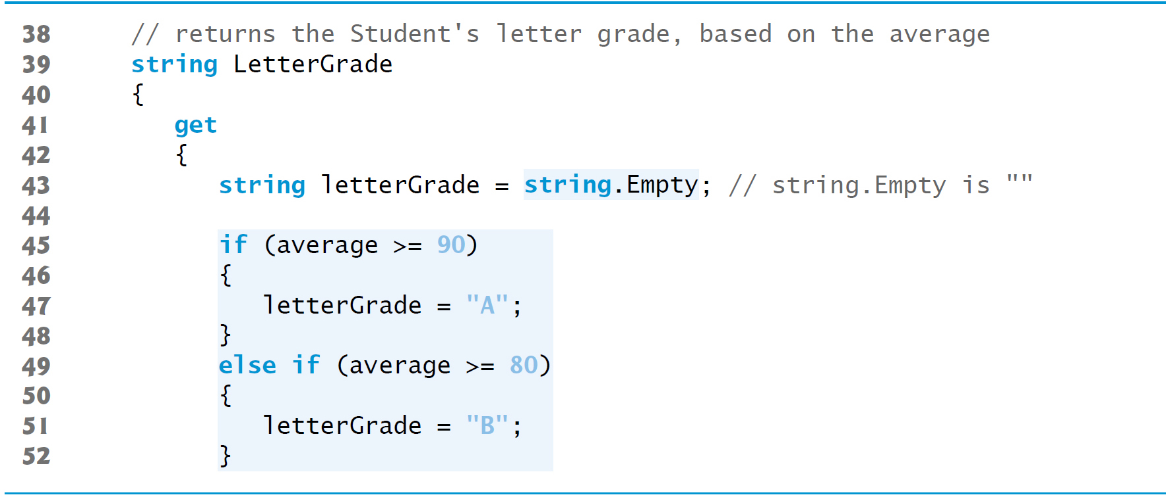
Figure 5.5 Student Class That Stores a Student Name and Average (3 of 4)

Slide 45
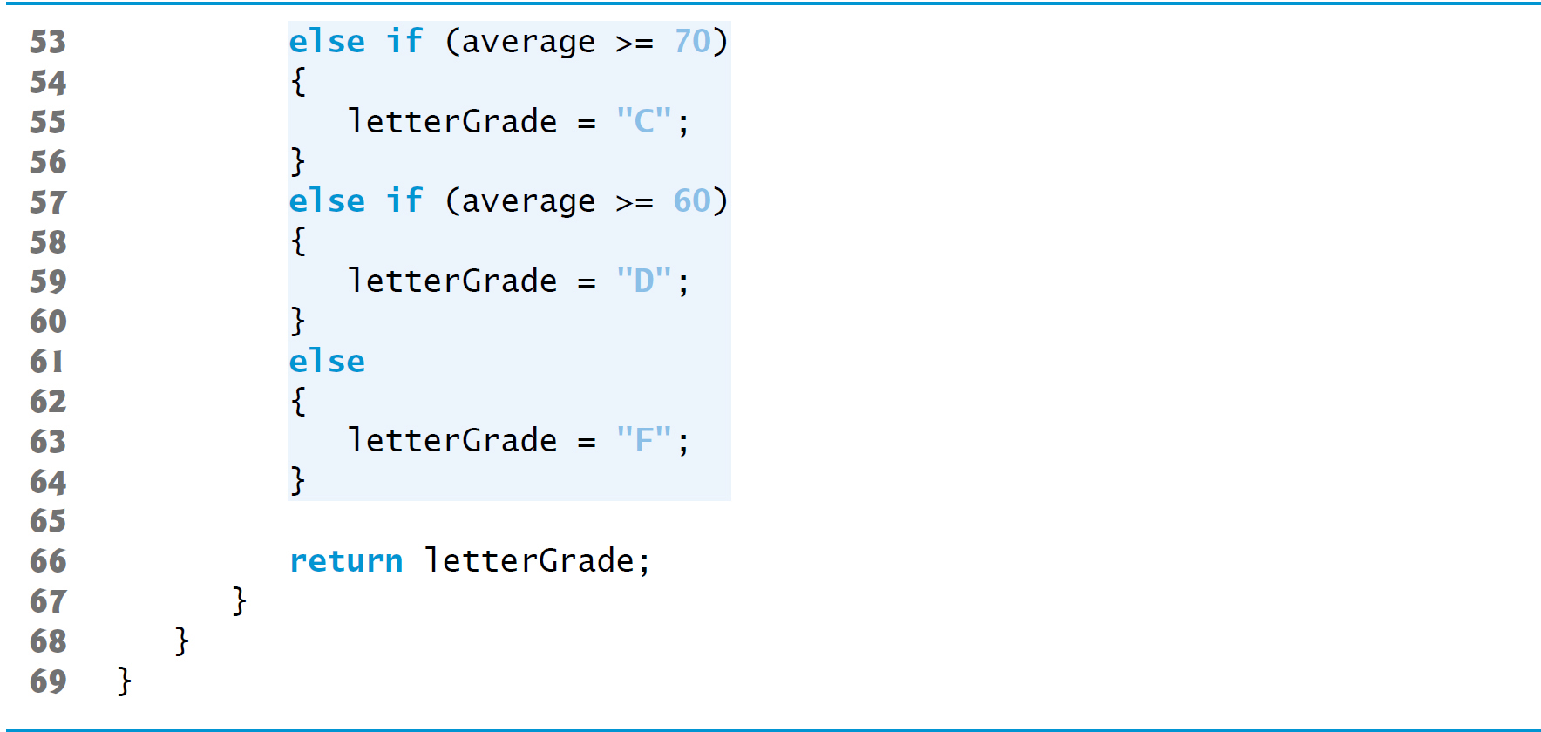
Figure 5.5 Student Class That Stores a Student Name and Average (4 of 4)

Slide 46
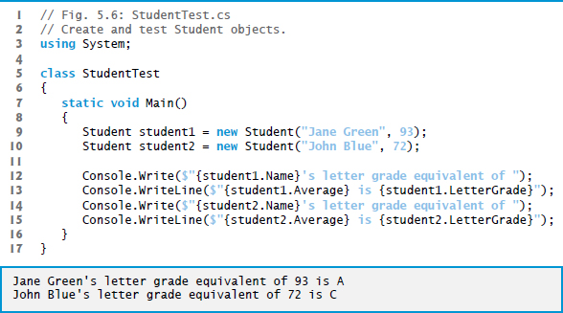
Figure 5.6 Create and Test Student Objects

Slide 47
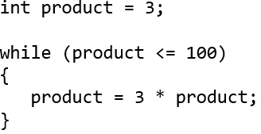
5.8 while Iteration Statement (1 of 2)
A iteration statement allows you to specify that an app should repeat an action:
While there are more items on my shopping list
put next item in cart and cross it off my list
As an example of
while iteration statement,
Consider a code segment designed to find the first power of 3 larger than 100:

Slide 48
Common Programming Error 5.2
Not providing in the body of a while statement an action that eventually causes the condition in the while to become false results in a logic error called an infinite loop (the loop never terminates). This often will make your program appear to “hang.”

Slide 49
5.8 while Iteration Statement (2 of 2)
The U M L activity diagram in Figure 5.7 illustrates the flow of control in the preceding while statement.
This diagram introduces the U M L’s merge symbol.
The U M L represents both the merge symbol and the decision symbol as diamonds.
The merge symbol joins multiple flows of activity into one.
In this diagram, the merge symbol joins the transitions from the initial state and from the action state, so they both flow into the decision that determines whether the loop should begin (or continue) executing

Slide 50
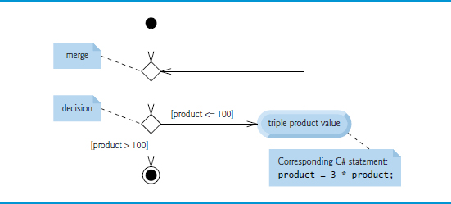
Figure 5.7 while Iteration Statement U M L Activity Diagram

Slide 51
5.9 Formulating Algorithms: Counter-Controlled Iteration
Consider the following problem statement:
A class of 10 students took a quiz. The grades (integers in
the range 0 to 100) for this quiz are available to you.
Determine the class average on the quiz.
The algorithm must input each grade, keep track of the total of all grades input, perform the averaging calculation and display the result.

Slide 52
5.9.1 Pseudocode Algorithm with Counter-Controlled Iteration
Pseudocode Algorithm with Counter-Controlled Iteration
We use counter-controlled iteration to input the grades one at a time.
A variable called a counter controls the number of times a set of statements will execute.
Counter-controlled iteration is often called definite iteration, because the number of iterations is known before the loop begins executing.
Figure 5.8 expresses the algorithm in pseudocode.
A total is a variable used to accumulate the sum of several values.
A counter is a variable used to count.

Slide 53
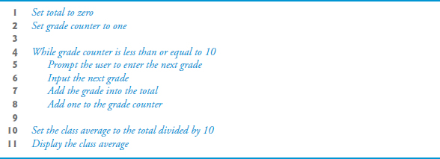
Figure 5.8 Pseudocode Algorithm That Uses Counter-Controlled Iteration to Solve the Class-Average Problem

Slide 54
Software Engineering Observation 5.1
Experience has shown that the most difficult part of solving a problem on a computer is developing the algorithm for the solution. Once a correct algorithm has been specified,
producing a working
program from it is usually
straightforward.

Slide 55
5.9.2 Implementing Counter-Controlled Iteration (1 of 2)
In Figure 5.9, method Main implements the class-averaging algorithm described by the pseudocode in —it allows the user to enter 10 grades, then calculates and displays the average

Slide 56
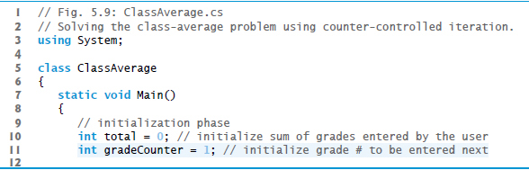
Figure 5.9 Solving the Class-Average Problem Using Counter-Controlled Iteration (1 of 3)

Slide 57
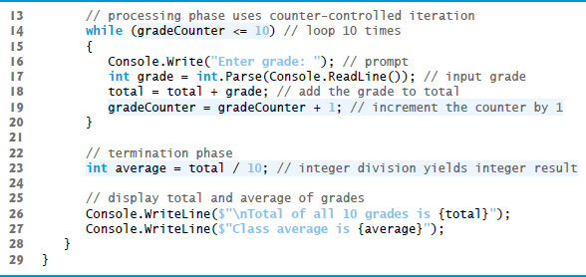
Figure 5.9 Solving the Class-Average Problem Using Counter-Controlled Iteration (2 of 3)

Slide 58

Figure 5.9 Solving the Class-Average Problem Using Counter-Controlled Iteration (3 of 3)

Slide 59
5.9.2 Implementing Counter-Controlled Iteration (2 of 2)
requires local variables to be definitely assigned—that is, each local variable must be assigned a value before the variable’s value is used.

Slide 60
Common Programming Error 5.3
All local variables must be definitely assigned before their values are used in expressions. Using a local variable’s value before it’s definitely assigned results in a compilation error.

Slide 61
Error-Prevention Tip 5.2
Initializing local variables when they’re declared helps you avoid compilation errors that might arise from attempts to
use uninitialized data. While
does not require that local-
variable initializations be incorporated into declarations, it does require that local variables be initialized before their values are used in an expression.

Slide 62
Error-Prevention Tip 5.3
Initialize each counter and total, either in its declaration or in an assignment statement. Totals are normally initialized to 0. Counters are normally initialized to 0 or 1, depending on how they’re used (we’ll show examples of each).

Slide 63
5.9.3 Integer Division and Truncation
Dividing two integers results in integer division.
Any fractional part of the result is lost (i.e., truncated, not rounded).

Slide 64
Common Programming Error 5.4
Assuming that integer division rounds (rather than truncates) can lead to incorrect results. For example, 7 ÷ 4, which yields 1.75 in conventional arithmetic, truncates to 1 in integer arithmetic, rather than rounding to 2.

Slide 65
5.10 Formulating Algorithms: Sentinel-Controlled Iteration
Consider the following problem:
Develop a class-averaging app that processes grades for an arbitrary number of students each time it’s run.
In this example, no indication is given of how many grades the user will enter during the app’s execution.
A sentinel value can be entered to indicate “end of data entry.” This is called sentinel-controlled iteration.
Sentinel-controlled iteration is often called indefinite iteration because the number of iterations is not known before the loop begins.

Slide 66
5.10.1 Top-Down, Stepwise Refinement: The Top and First Refinement
We approach the class averaging program with a technique called top-down, stepwise refinement.
The top conveys the overall function of the app: determine the class average for the quiz
We divide the top into a series of smaller tasks in the first refinement:
initialize variables
input, sum and count the quiz grades
calculate and display the class average

Slide 67
Software Engineering Observation 5.2
Each refinement, as well as the top itself, is a complete specification of the algorithm—only the level of detail varies.

Slide 68
Software Engineering Observation 5.3
Many programs can be divided logically into three phases: an initialization phase that initializes the variables; a processing phase that inputs data values and adjusts program variables accordingly; and a termination phase that calculates and outputs the final results.

Slide 69
5.10.2 Second Refinement (1 of 3)
The second refinement specifies individual variables.
initialize variables
This can be refined as follows:
initialize total to zero
initialize counter to zero

Slide 70
5.10.2 Second Refinement (2 of 3)
input, sum and count the quiz grades
The second refinement of the preceding pseudocode state­ment is:
prompt the user to enter the first grade
input the first grade (possibly the sentinel)
while the user has not yet entered the sentinel
add this grade into the running total add one to the grade counter prompt the user to enter the next grade input the next grade (possibly the sentinel)

Slide 71
5.10.2 Second Refinement (3 of 3)
calculate and display the class average
The preceding pseudocode can be refined as follows:
if the counter is not equal to zero
set the average to the total divided by the counter display the average
else display “No grades were entered”
We are careful here to test for the possibility of division by zero.
The complete second refinement of the pseudocode for the class-average problem is shown in Figure 5.10.

Slide 72
Error-Prevention Tip 5.4
When performing division by an expression whose value could be zero, explicitly test for this possibility and handle it appropriately in your app (e.g., by displaying an error message) rather than allowing the error to occur.

Slide 73
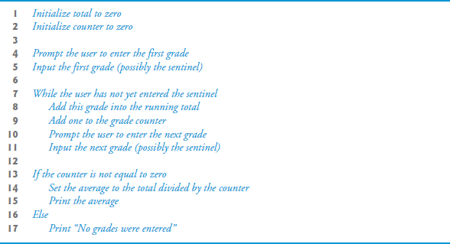
Figure 5.10 Class-Averaging Pseudocode Algorithm with Sentinel-Controlled Iteration

Slide 74
Software Engineering Observation 5.4
Terminate the top-down, stepwise refinement process when you’ve specified the pseudocode algorithm in sufficient detail for you to convert the pseudocode to

Slide 75
Software Engineering Observation 5.5
Some programmers do not use program-development tools like pseudocode. They feel that their ultimate goal is to solve the problem on a computer and that writing pseudocode merely delays the production of final outputs. Although this may work for simple and familiar problems, it can lead to serious errors and delays in large, complex projects.

Slide 76
5.10.3 Implementing Sentinel-Controlled Iteration
In Figure 5.11, method Main implements the pseudocode algorithm of Figure 5.10.
Although each grade entered by the user is an integer, the averaging calculation is likely to produce a number with a decimal.
The type int cannot represent such a number.
provides data types float and double to store floating-point numbers in memory.

Slide 77
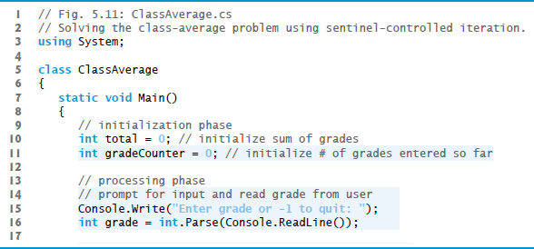
Figure 5.11 Solving the Class-Average Problem Using Sentinel-Controlled Iteration (1 of 4)

Slide 78
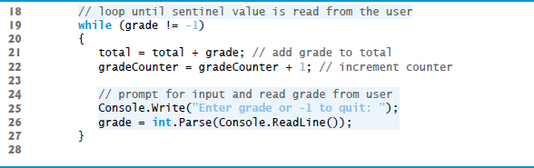
Figure 5.11 Solving the Class-Average Problem Using Sentinel-Controlled Iteration (2 of 4)

Slide 79
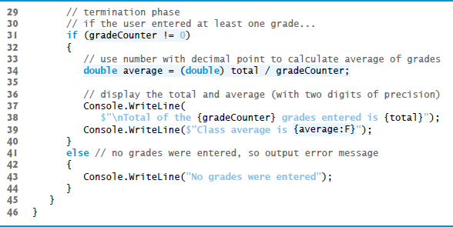
Figure 5.11 Solving the Class-Average Problem Using Sentinel-Controlled Iteration (3 of 4)

Slide 80
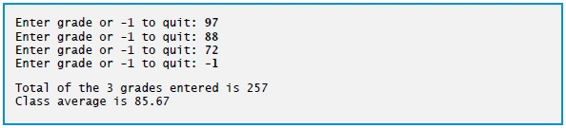
Figure 5.11 Solving the Class-Average Problem Using Sentinel-Controlled Iteration (4 of 4)

Slide 81
Good Programming Practice 5.3
In a sentinel-controlled loop, prompts should remind the user of the sentinel.

Slide 82
Error-Prevention Tip 5.5
Omitting the braces that delimit a block can lead to logic errors, such as infinite loops. To prevent this and other problems, we always enclose the body of every control statement in braces even if the body contains only a single statement.

Slide 83
5.10.6 Converting Between Simple Types Explicitly and Implicitly
To perform a floating-point calculation with integer values, we temporarily treat these values as floating-point numbers.
A unary cast operator such as (double) performs explicit conversion.
performs an operation called promotion (or implicit conversion) on selected operands for use in the expression.
The cast operator is formed by placing parentheses around the name of a type.
This operator is a unary operator (i.e., an operator that takes only one operand).
Cast operators have the second highest precedence.

Slide 84


5.10.7 Formatting Floating-Point Numbers
Line 39
outputs the class average.
The format specifier F in the interpolation expression
typically formats average’s value with two digits to the right of the decimal point
the Windows culture settings on the user’s machine determine the actual format, including the digits to the right of the decimal point, whether commas or periods are used for separating thousands, millions, etc.

Slide 85
5.11 Formulating Algorithms: Nested Control Statements
We’ve seen that control statements can be stacked on top of one another (in sequence).
In this case study, we examine the only other struc-tured way control statements can be connected, namely, by nesting one control statement within another.

Slide 86
5.11.1 Formulating Algorithms: Nested Control Statements (1 of 3)
A college offers a course that prepares students for the state licensing exam for real estate brokers. Last year, 10 of the students who completed this course took the exam. The college wants to know how well its students did on the exam. You’ve been asked to write an app to summarize the results. You’ve been given a list of these 10 students. Next to each name is written a 1 if the student passed the exam or a 2 if the student failed.

Slide 87
5.11.1 Formulating Algorithms: Nested Control Statements (2 of 3)
Your app should analyze the results of the exam as follows:
Input each test result (i.e., a 1 or a 2). Display the message “Enter result” on the screen each time the app requests another test result.
Count the number of test results of each type.
Display a summary of the test results indicating the number of students who passed and the number who failed.
If more than eight students passed the exam, display the message “Bonus to instructor!”

Slide 88
5.11.1 Formulating Algorithms: Nested Control Statements (3 of 3)
After reading the problem statement, we make the following observations:
The app must process test results for 10 students. A counter-controlled loop can be used because the number of test results is known in advance.
Each test result has a numeric value—either a 1 or a 2. Each time the app reads a test result, the app must determine whether the number is a 1 or a 2. We test for a 1 in our algorithm. If the number is not a 1, we assume that it’s a 2.
Two counters are used to keep track of the exam results—one to count the number of students who passed the exam and one to count the number of students who failed the exam.
After the app has processed all the results, it must determine whether more than eight students passed the exam.

Slide 89
5.11.2 Top-Down, Stepwise Refinement: Pseudocode Representation of the Top
Proceed with top-down, stepwise refinement:
analyze exam results and decide whether the instructor should receive a bonus

Slide 90
5.11.3 Top-Down, Stepwise Refinement: First Refinement
Proceed with top-down, stepwise refinement:
analyze exam results and decide whether the instructor should receive a bonus
Our first refinement is
initialize variables
input the 10 exam results, and count passes and failures
display a summary of the exam results and decide whether the instructor should receive a bonus

Slide 91
5.11.4 Top-Down, Stepwise Refinement: Second Refinement (1 of 3)
initialize variables
The preceding pseudocode statement can be refined as follows:
initialize passes to zero
initialize failures to zero
initialize student counter to one

Slide 92
5.11.4 Top-Down, Stepwise Refinement: Second Refinement (2 of 3)
input the 10 exam results, and count passes and failures
A nested double-selection statement will determine whether each exam result is a pass or a failure:
while student counter is less than or equal to 10
prompt the user to enter the next exam result input the next exam result
if the student passed
add one to passes
else
add one to failures
add one to student counter

Slide 93
5.11.4 Top-Down, Stepwise Refinement: Second Refinement (3 of 3)
display a summary of the exam results and decide whether the instructor should receive a bonus
can be refined as follows:
display the number of passes
display the number of failures
if more than eight students passed
display “Bonus to Instructor!”

Slide 94
5.11.5 Complete Second Refinement of the Pseudocode
The complete second refinement of the pseudocode appears in Figure 5.12.

Slide 95
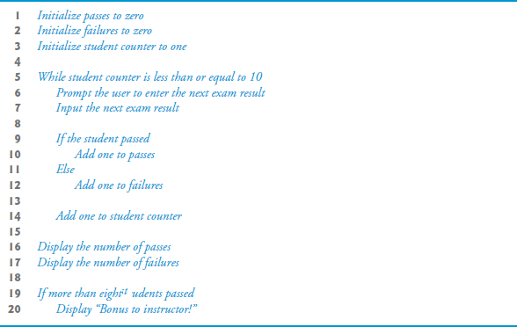
Figure 5.12 Pseudocode for the Examination-Results Problem

Slide 96
5.11.6 App That Implements the Pseudocode Algorithm
The program that implements the algorithm is shown in Figure 5.13.

Slide 97
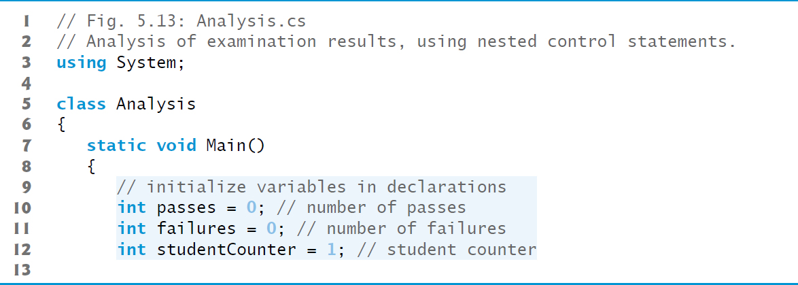
Figure 5.13 Analysis of Examination Results, Using Nested Control Statements (1 of 5)

Slide 98
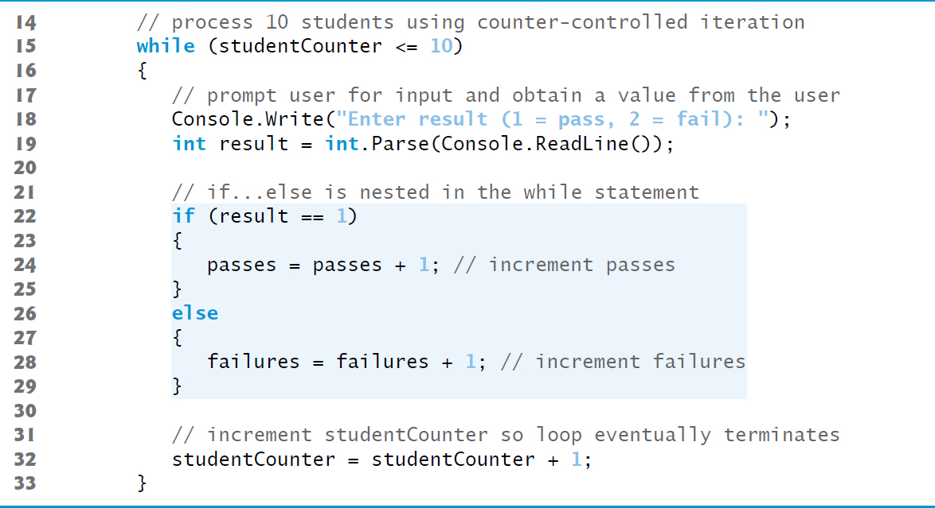
Figure 5.13 Analysis of Examination Results, Using Nested Control Statements (2 of 5)

Slide 99
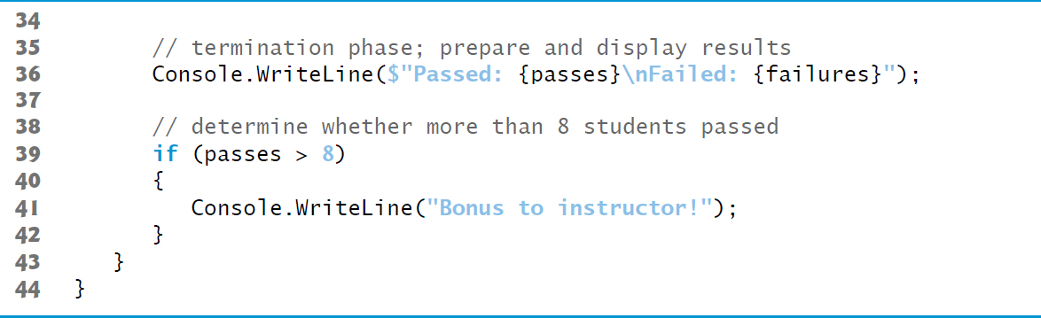
Figure 5.13 Analysis of Examination Results, Using Nested Control Statements (3 of 5)

Slide 100
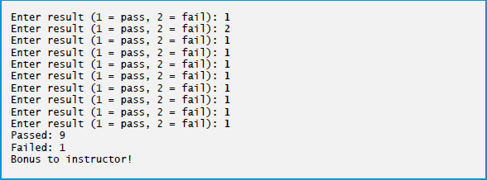
Figure 5.13 Analysis of Examination Results, Using Nested Control Statements (4 of 5)

Slide 101
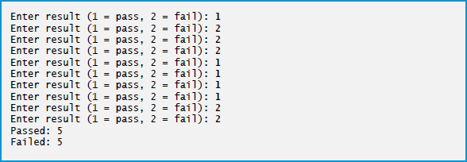
Figure 5.13 Analysis of Examination Results, Using Nested Control Statements (5 of 5)

Slide 102
5.12 Compound Assignment Operators (1 of 2)
provides several compound assignment operators
For example, you can abbreviate the statement
c = c + 3;
with the addition compound assignment operator,

Slide 103
5.12 Compound Assignment Operators (2 of 2)
Figure 5.14 shows the arithmetic compound assignment operators, sample expressions using the operators and explanations of what the operators do.

Slide 104
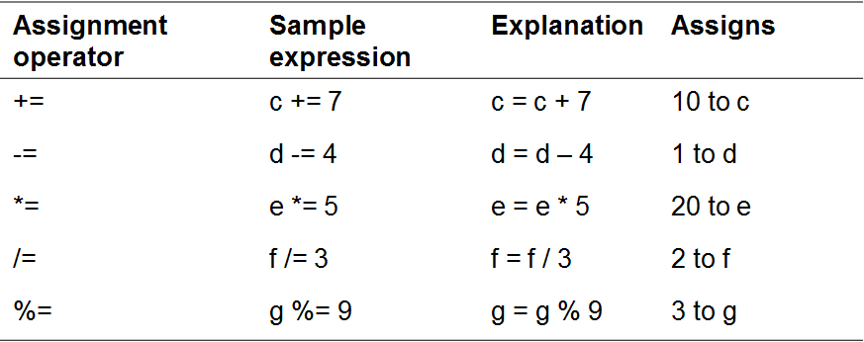
Figure 5.14 Arithmetic Compound Assignment Operators.
Assume: int c = 3, d = 5, e = 4, f = 6, g = 12;

Slide 105
5.13 Increment and Decrement Operators
provides operators for adding or subtracting 1 from a numeric variable (Figure 5.15).
The unary increment operator,
The unary decrement operator,

Slide 106
Figure 5.15 Increment and Decrement Operators
Operator | Sample expression | Explanation
Plus plus (prefix increment) | Plus plus a | Increments a by 1 and uses the new value of a in the expression in which a resides.
Plus plus (postfix increment) | a Plus plus | Increments a by 1, but uses the original value of a in the expression in which a resides.
Hyphen hyphen (prefix decrement) | Hyphen hyphen b | Decrements b by 1 and uses the new value of b in the expression in which b resides.
Hyphen hyphen (postfix decrement) | b Hyphen hyphen | Decrements b by 1 but uses the original value of b in the expression in which b resides.

Slide 107
Good Programming Practice 5.4
Unlike binary operators, the unary increment and decrement operators as a matter of style should be placed next to their operands, with no intervening spaces.

Slide 108
5.13.1 Prefix Increment vs. Postfix Increment
Figure 5.16 demonstrates the difference between the prefix increment and postfix increment versions of the
increment operator.

Slide 109
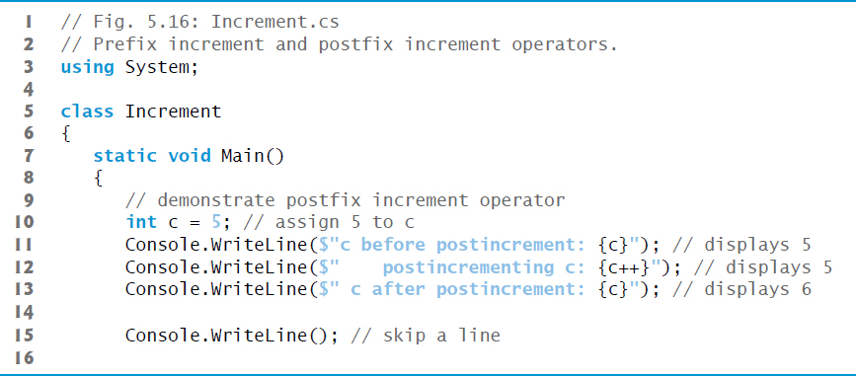
Figure 5.16 Prefix-Increment and Postfix-Increment Operators (1 of 2)

Slide 110
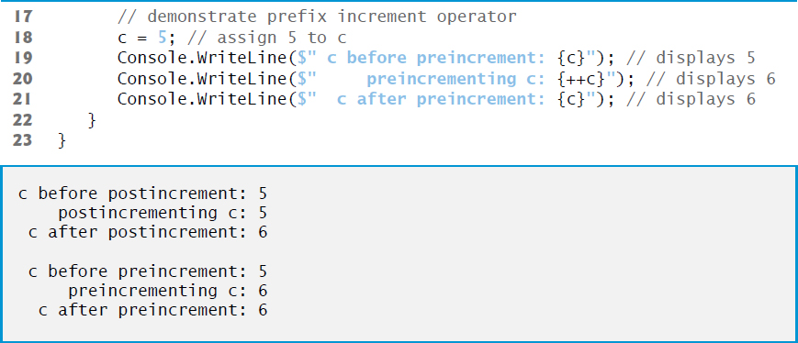
Figure 5.16 Prefix-Increment and Postfix-Increment Operators (2 of 2)

Slide 111
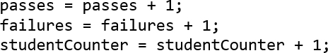
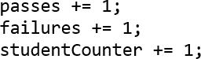
5.13.2 Simplifying Increment Statements (1 of 2)
can be written more concisely with compound assignment operators:

Slide 112
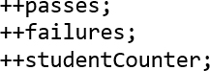
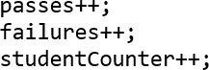
5.13.2 Simplifying Increment Statements (2 of 2)
This is even more precise with prefix increment operators:
Or with postfix increment operators:

Slide 113
Common Programming Error 5.5
Attempting to use the increment or decrement operator on an expression other than one to which a value can be assigned is a syntax error. For example, writing
is a syntax error, because
is not an expression to
which a value can be assigned.

Slide 114
5.13.3 Operator Precedence and Associativity
Figure 5.17 shows the precedence and associativity of the operators we’ve introduced to this point.

Slide 115
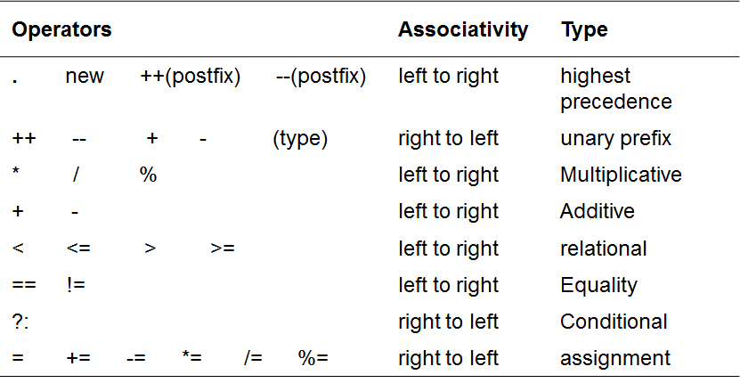
Figure 5.17 Precedence and Associativity of the Operators Discussed So Far

Slide 116
5.14 Simple Types
The table in Appendix B, Simple Types, lists the 13 simple types in
requires all variables to have a type.
Instance variables of types char, byte, sbyte, short, ushort, int, uint, long, ulong, float, double, and decimal are all given the value 0 by default.
Instance variables of type bool are given the value false by default.
Reference-type instance variables are initialized by default to the value null.

Slide 117
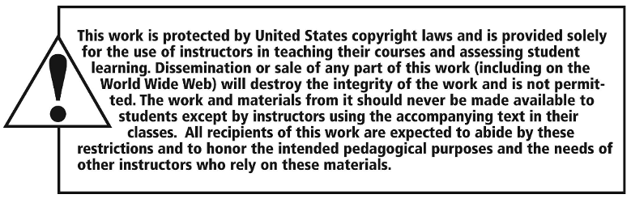
Copyright

